Slide 1


Constraints and Lagrangian Dynamics
Dr. Yogesh Sonvane
Assistant Professor
Department of Applied Physics
Sardar Vallabhbhai National Institute of Technology, Surat

Slide 2
Constraints
Discussion up to now ⇒ All mechanics is reduced to solving a set of simultaneous, coupled, 2nd order differential eqtns which come from Newton’s 2nd Law applied to each mass individually:
(dp_{i}/dt) = m_{i}(d²r_{i}/dt²) = F_{i}^{(e)} + ∑_{j}F_{ji}
⇒ Given forces & initial conditions, problem is reduced to pure math!
Oversimplification!! Many systems have CONSTRAINTS which limit their motion.
Example: Rigid Body. Constraints keep r_{ij} = constant.
Example: Particle motion on surface of sphere.

Slide 3
Types of Constraints
In general, constraints are expressed as a mathematical relation or relations between particle coordinates & possibly the time.
Eqtns of constraint are relations like:
f(r₁,r₂,r₃,…r_{N},t) = 0
Constraints which may be expressed as above:
≡ Holonomic Constraints.
Example of Holonomic Constraint: Rigid body. Constraints on coordinates are of the form:
(r_{i} - r_{j})² - (c_{ij})² = 0
c_{ij} = some constant

Slide 4
Constraints not expressible as f(r_{i},t) = 0
≡ Non-Holonomic Constraints
Example of Non-Holonomic Constraint: Particle confined to surface of rigid sphere, radius a: r² - a² ≥ 0
Time dependent constraints:
≡ Rhenomic or Rhenomous Constraints.
If constraint eqtns don’t explicitly contain time: ≡ Fixed or Scleronomic or Scleronomous Constraints.

Slide 5
Difficulties constraints introduce in problems:
1. Coordinates r_{i} are no longer all independent. Connected by constraint eqtns.
2. To apply Newton’s 2nd Law, need TOTAL force acting on each particle. Forces of constraint aren’t always known or easily calculated.
⇒ With constraints, it’s often difficult to directly apply Newton’s 2nd Law.
Put another way: Forces of constraint are often among the unknowns of the problem!

Slide 6
Generalized Coordinates
To handle the 1st difficulty (with holonomic constraints), introduce Generalized Coordinates.
Alternatives to usual Cartesian coordinates.
System (3d) N particles & no constraints.
⇒ 3N degrees of freedom
(3N independent coordinates)
With k holonomic constraints, each expressed by eqtn of form:
f_{m}(r₁,r₂,r₃,…r_{N},t) = 0 (m = 1, 2, … k)
⇒ 3N - k degrees of freedom
(3N - k independent coordinates)

Slide 7
General mechanical system with s = 3N - k degrees of freedom (3N - k independent coordinates).
Introduce s = 3N - k independent Generalized Coordinates to describe system:
Notation: q₁,q₂, … Or: q ( = 1,2,… s)
In principle, can always find relations between generalized coordinates & Cartesian (vector) coordinates of form: r_{i} = r_{i} (q₁,q₂,q₃,.,t) (i = 1,2,3,…N)
These are transformation eqtns from the set of coordinates (r_{i} ) to the set (q) . They are parametric representations of (r_{i} )
In principle, can combine with k constraint eqtns to obtain inverse relations q = q(r₁,r₂,r₃,..t) ( = 1,2,… s)

Slide 8
Generalized Coordinates ≡ Any set of s quantities which completely specifies the state of the system (for a system with s degrees of freedom).
These s generalized coords need not be Cartesian! Can choose any set of s coordinates which completely describes state of motion of system. Depending on problem:
Could have s curvilinear (spherical, cylindrical, ..) coords
Could choose mixture of rectangular coords (m = # rectangular coords) & curvilinear (s - m = # curvilinear coords)
The s generalized coords needn’t have units of length! Could be dimensionless or have (almost) any units.

Slide 9
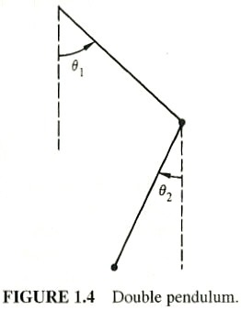
Generalized coords, q will (often) not divide into groups of 3 that can be associated with vectors.
Example: Particle on sphere surface: A convenient choice of
q = latitude & longitude.
Example: Double pendulum:
A convenient choice of
q = θ₁ & θ₂ (Figure) →

Slide 10
Sometimes, it’s convenient & useful to use Generalized Coords (non-Cartesian) even in systems with no constraints.
Example: Central force field problems:
V = V(r), it makes sense to use spherical coords!
Generalized coords need not be orthogonal coordinates & need not be position coordinates.

Slide 11
Non-Holonomic constraint:
⇒ Eqtns expressing constraint can’t be used to eliminate dependent coordinates.
Example: Object rolling without slipping on a rough surface. Coordinates needed to describe motion: Angular coords to specify body orientation + coords to describe location of point of contact of body & surface. Constraint of rolling ⇒ Connects 2 coord sets: They aren’t independent. BUT, # coords cannot be reduced by the constraint, because cannot express rolling condition as eqtn between coords! Instead, (can show) rolling constraint is condition on the velocities: a differential eqtn which can be integrated only after solution to problem is known!

Slide 12
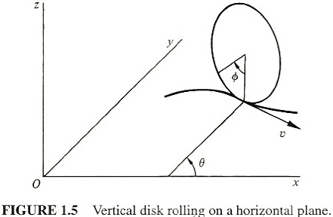
Example: Rolling Constraint
Disk, radius a, constrained to be vertical, rolling on the horizontal (xy) plane. Figure:
Generalized coords: x, y of point of contact of disk with plane + θ = angle between disk axis & x-axis + φ = angle of rotation about disk axis

Slide 13
Constraint: Velocity v of
disk center is related to
angular velocity (dφ/dt)
of disk rotation:
v = a(dφ/dt) (1)
Also Cartesian components of v:
v_{x} = (dx/dt) = v sinθ, v_{y} = (dy/dt) = -v cosθ (2)
Combine (1) & (2) (multiplying through by dt):
⇒ dx - a sinθ dφ = 0 dy + a cosθ dφ = 0
Neither can be integrated without solving the problem! That is, a function f(x,y,θ,φ) = 0 cannot be found. Physical argument that φ must be indep of x,y,θ: See pp. 15 & 16

Slide 14
Non-Holonomic constraints can also involve higher order derivatives or inequalities.
Holonomic constraints are preferred, since easiest to deal with. No general method to treat problems with Non-Holonomic constraints. Treat on case-by-case basis.
In special cases of Non-Holonomic constraints, when constraint is expressed in differential form (as in example), can use method of Lagrange multipliers along with Lagrange’s eqtns.
Authors argue, except for some macroscopic physics textbook examples, most problems of practical interest to physicists are microscopic & the constraints are holonomic or do not actually enter the problem.

Slide 15
Difficulties constraints introduce:
1. Coordinates r_{i} are no longer all independent. Connected by constraint eqtns.
Have now thoroughly discussed this problem!
2. To apply Newton’s 2nd Law, need the TOTAL force acting on each particle. Forces of constraint are not always known or easily calculated.
⇒ With constraints, it’s often difficult to directly apply Newton’s 2nd Law.
Put another way: Forces of constraint are often among the unknowns of the problem! To address this, long ago, people reformulated mechanics. Lagrangian & Hamiltonian formulations. No direct reference to forces of constraint.

Slide 16
D’Alembert’s Principle & Lagrange’s Equations
Virtual (infinitesimal) displacement ≡ Change in the system configuration as result of an arbitrary infinitesimal change of coordinates δr_{i}, consistent with the forces & constraints imposed on the system at a given time t.
“Virtual” distinguishes it from an actual displacement dr_{i}, occurring in small time interval dt (during which forces & constraints may change)

Slide 17
Consider the system at equilibrium: The total force on each particle is F_{i} = 0. Virtual work done by F_{i} in displacement δr_{i}:
δW_{i} = F_{i}•δr_{i} = 0. Sum over i:
⇒ δW = ∑_{i}F_{i}•δr_{i} = 0.
Decompose F_{i} into applied force F_{i}^{(a)} & constraint force f_{i}: F_{i} = F_{i}^{(a)} + f_{i}
⇒ δW = ∑_{i} (F_{i}^{(a)} + f_{i} )•δr_{i} ≡ δW^{(a)} + δW^{(c)} = 0
Special case (often true, see text discussion): Systems for which the net virtual work due to constraint forces is zero: ∑_{i}f_{i}•δr_{i} ≡ δW^{(c)} = 0

Slide 18
Principle of Virtual Work
⇒ Condition for system equilibrium: Virtual work
due to APPLIED forces vanishes:
δW^{(a)} = ∑_{i}F_{i}^{(a)}•δr_{i} = 0 (1)
≡ Principle of Virtual Work
Note: In general coefficients of δr_{i} , F_{i}^{(a)} ≠ 0 even though ∑_{i}F_{i}^{(a)}•δr_{i} = 0 because δr_{i} are not independent, but connected by constraints.
In order to have coefficients of δr_{i} = 0, must transform Principle of Virtual Work into a form involving virtual displacements of generalized coordinates q , which are independent. (1) is good since it does not involve constraint forces f_{i} . But so far, only statics. Want to treat dynamics!

Slide 19
D’Alembert’s Principle
Dynamics: Start with Newton’s 2nd Law for particle i: F_{i} = (dp_{i}/dt) Or: F_{i} - (dp_{i}/dt) = 0
⇒ Can view system particles as in “equilibrium” under a force
= actual force + “reversed effective force” = -(dp/dt)
Virtual work done is
δW = ∑_{i}[F_{i} - (dp_{i}/dt)]•δr_{i} = 0
Again decompose F_{i}: F_{i} = F_{i}^{(a)} + f_{i}
⇒ δW = ∑_{i}[F_{i}^{(a)} - (dp_{i}/dt) + f_{i} ]•δr_{i} = 0
Again restrict consideration to special case: Systems for which the net virtual work due to constraint forces is zero: ∑_{i} f_{i}•δr_{i} ≡ δW^{(c)} = 0

Slide 20
⇒ δW = ∑_{i}[F_{i} - (dp_{i}/dt)]•δr_{i} = 0 (2)
≡ D’Alembert’s Principle
Dropped the superscript (a)!
Transform (2) to an expression involving virtual displacements of q (which, for holonomic constraints, are indep of each other). Then, by linear independence, the coefficients of the δq = 0

Slide 21
δW = ∑_{i}[F_{i} - (dp_{i}/dt)]•δr_{i} = 0 (2)
Much manipulation follows! Only highlights here!
Transformation eqtns:
r_{i} = r_{i}(q₁,q₂,q₃,.,t) (i = 1,2,3,…n)
Chain rule of differentiation (velocities):
v_{i} ≡ (dr_{i}/dt) = ∑_{k}(∂r_{i}/∂q_{k})(dq_{k}/dt) + (∂r_{i}/∂t) (a)
Virtual displacements δr_{i} are connected to virtual
displacements δq: δr_{i} = ∑_{j} (∂r_{i}/∂q_{j})δq_{j} (b)

Slide 22
Generalized Forces
1st term of (2) (Combined with (b)):
∑_{i} F_{i} •δr_{i} = ∑_{i,j} F_{i} •(∂r_{i}/∂q_{j})δq_{j} ≡ ∑_{j}Q_{j}δq_{j} (c)
Define Generalized Force (corresponding to Generalized Coordinate q_{j}): Q_{j} ≡ ∑_{i}F_{i}•(∂r_{i}/∂q_{j})
Generalized Coordinates q_{j} need not have units of length!
⇒ Corresponding Generalized Forces Q_{j} need not have units of force!
For example: If q_{j} is an angle, corresponding Q_{j} will be a torque!

Slide 23
2nd term of (2) (using (b) again):
∑_{i}(dp_{i}/dt)•δr_{i} = ∑_{i}[m_{i} (d²r_{i}/dt²)•δr_{i} ] =
∑_{i,j}[m_{i} (d²r_{i}/dt²)•(∂r_{i}/∂q_{j})δq_{j}] (d)
Manipulate with (d): ∑_{i}[m_{i} (d²r_{i}/dt²)•(∂r_{i}/∂q_{j})] =
∑_{i}[d{m_{i}(dr_{i}/dt)•(∂r_{i}/∂q_{j})}/dt] – ∑_{i}[m_{i}(dr_{i}/dt)•d{(∂r_{i}/∂q_{j})}/dt]
Also: d{(∂r_{i}/∂q_{j})}/dt = ∂{dr_{i}/dt}/∂q_{j} ≡ (∂v_{i}/∂q_{j})
Use (a): (∂v_{i}/∂q_{j}) = ∑_{k}(∂²r_{i}/∂q_{j}∂q_{k})(dq_{k}/dt) + (∂²r_{i}/∂q_{j}∂t)
From (a): (∂v_{i}/∂q_{j}) = (∂r_{i}/∂q_{j})
So: ∑_{i}[m_{i} (d²r_{i}/dt²)•(∂r_{i}/∂q_{j})]
= ∑_{i}[d{m_{i}v_{i}•(∂v_{i}/∂q_{j})}/dt] - ∑_{i}[m_{i}v_{i}•(∂v_{i}/∂q_{j})]

Slide 24
More manipulation ⇒ (2) is: ∑_{i}[F_{i}-(dp_{i}/dt)]•δr_{i} = 0
∑_{j}{d[∂(∑_{i} (½)m_{i}(v_{i})²)/∂q_{j}]/dt - ∂(∑_{i}(½)m_{i}(v_{i})²)/∂q_{j} - Q_{j}}δq_{j} = 0
System kinetic energy is: T ≡ (½)∑_{i}m_{i}(v_{i})²
⇒ D’Alembert’s Principle becomes
∑_{j}{(d[∂T/∂q_{j}]/dt) - (∂T/∂q_{j}) - Q_{j}}δq_{j} = 0 (3)
Note: If q_{j} are Cartesian coords, (∂T/∂q_{j}) = 0
⇒ In generalized coords, (∂T/∂q_{j}) comes from the curvature of the q_{j}. (Example: Polar coords, (∂T/∂θ) becomes the centripetal acceleration).
So far, no restriction on constraints except that they do no work under virtual displacement. q_{j} are any set.
Special case: Holonomic Constraints ⇒ It’s possible to find sets of q_{j} for which each δq_{j} is independent.
⇒ Each term in (3) is separately 0!

Slide 25
Holonomic constraints ⇒ D’Alembert’s Principle:
(d[∂T/∂q_{j}]/dt) - (∂T/∂q_{j}) = Q_{j} (4)
(j = 1,2,3, … n)
Special case: A Potential Exists ⇒ F_{i} = - ∇_{i}V
Needn’t be conservative! V could be a function of t!
⇒ Generalized forces have the form
Q_{j} ≡ ∑_{i} F_{i}•(∂r_{i}/∂q_{j}) = - ∑_{i} ∇_{i}V•(∂r_{i}/∂q_{j}) ≡ - (∂V/∂q_{j})
Put this in (4): (d[∂T/∂q_{j}]/dt) - (∂[T-V]/∂q_{j}) = 0
So far, V doesn’t depend on the velocities q_{j}
⇒ (d/dt)[∂(T-V)/∂q_{j}] - ∂(T-V)/∂q_{j} = 0 (4´)

Slide 26
Lagrange’s Equations
Define: The Lagrangian L of the system:
L ≡ T - V
⇒ Can write D’Alembert’s Principle as:
(d/dt)[(∂L/∂q_{j})] - (∂L/∂q_{j}) = 0 (5) (j = 1,2,3, … n)
(5) ≡ Lagrange’s Equations

Slide 27
Lagrange’s Equations
Lagrangian: L ≡ T - V
Lagrange’s Eqtns:
(d/dt)[(∂L/∂q_{j})] - (∂L/∂q_{j}) = 0 (j = 1,2,3, … n)
Note: L is not unique, but is arbitrary to within the addition of a derivative (dF/dt). F = F(q,t) is any differentiable function of q’s & t.
That is, if we define a new Lagrangian L´
L´= L + (dF/dt)
It is easy to show that L´ satisfies the same Lagrange’s Eqtns (above).

Slide 28
Velocity-Dependent Potentials & the Dissipation Function
Non-conservative forces? It’s still possible, in a Special Case, to use Lagrange’s Eqtns unchanged, provided a Generalized or Velocity-Dependent Potential U = U(q_{j},q_{j}) exists, where the generalized forces Q_{j} are obtained as:
Q_{j} ≡ - (∂U/∂q_{j}) + (d/dt)[(∂U/∂q_{j})]
The Lagrangian is now: L ≡ T - U & Lagrange’s Eqtns are still:
(d/dt)[(∂L/∂q_{j})] - (∂L/∂q_{j}) = 0 (j = 1,2,3, … n)
A very important application: Electromagnetic forces on moving charges.

Slide 29
Electromagnetic Force Problem
Particle, mass m, charge q moving with velocity v in combined electric (E) & magnetic (B) fields.
Lorentz Force (SI units!):
F = q[E + (v × B)] (1)
E&M results that you should know!
E = E(x,y,z,t) & B = B(x,y,z,t) are derivable from a scalar potential φ = φ(x,y,z,t) and a vector potential A = A(x,y,z,t) as:
E ≡ - ∇φ - (∂A/∂t) (2)
B ≡ ∇ × A (3)

Slide 30
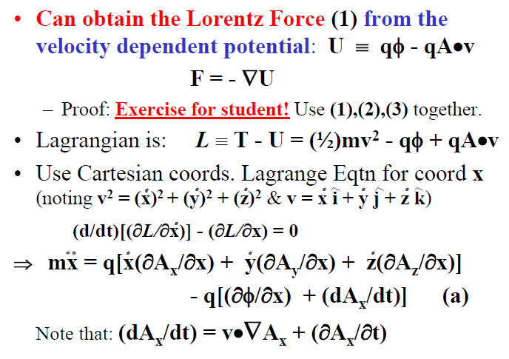

Slide 31
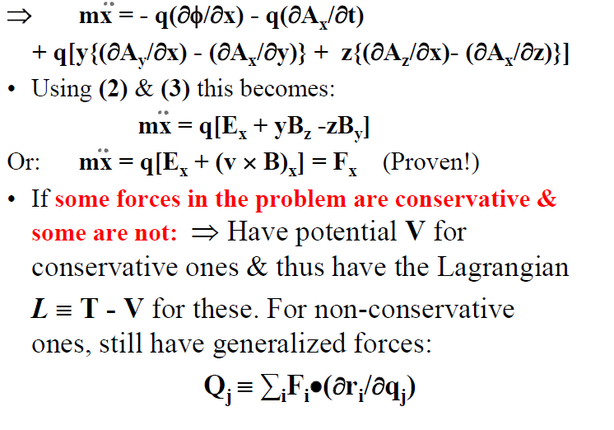

Slide 32
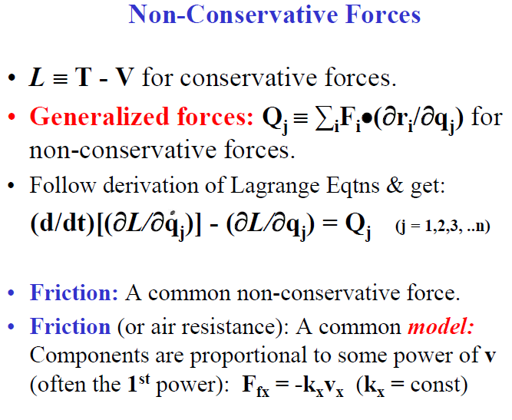

Slide 33
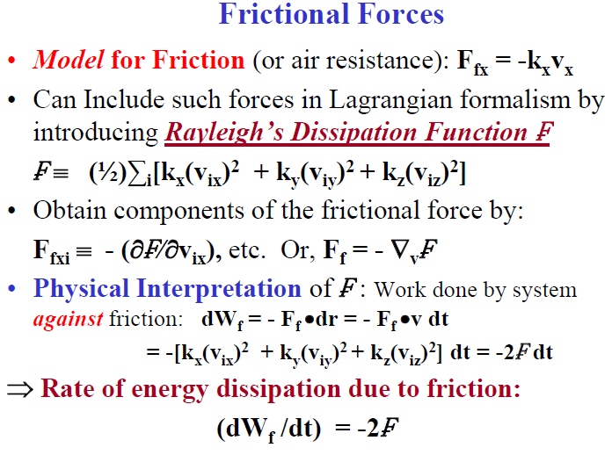

Slide 34
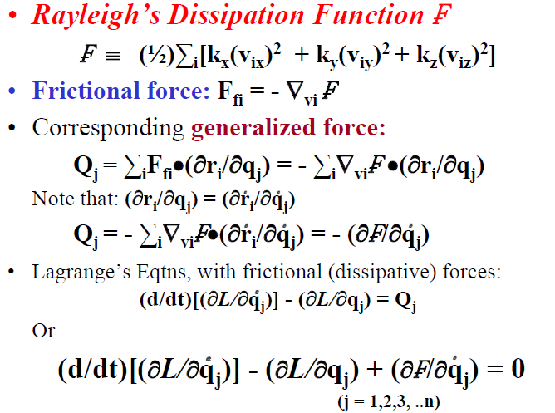

Slide 35
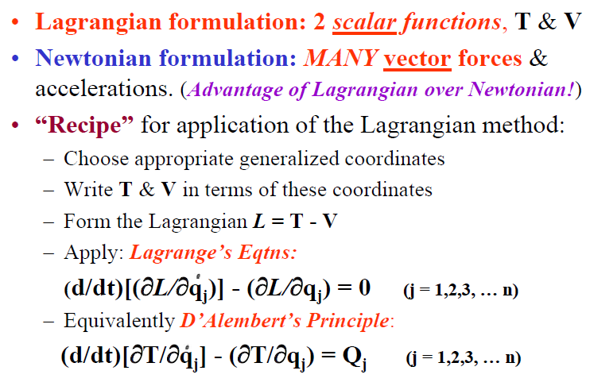
Simple Applications of the Lagrangian Formulation

Slide 36
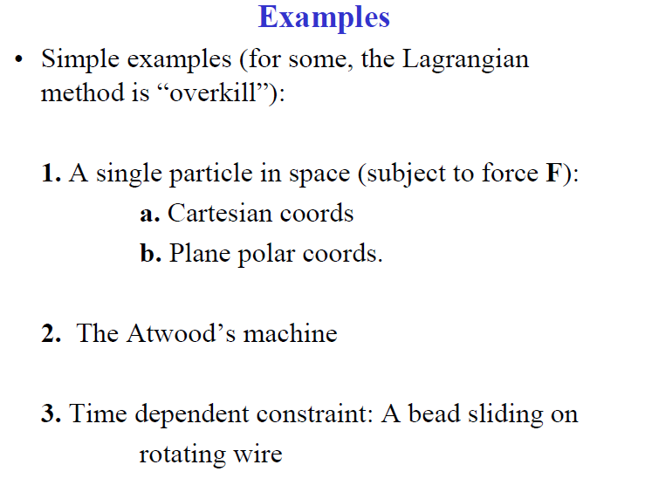

Slide 37
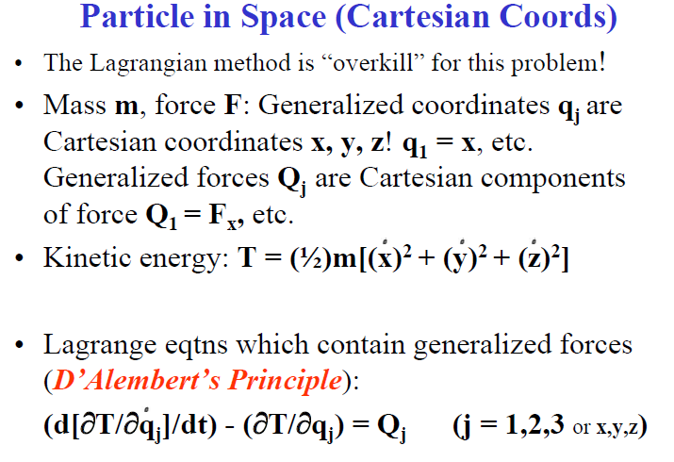

Slide 38
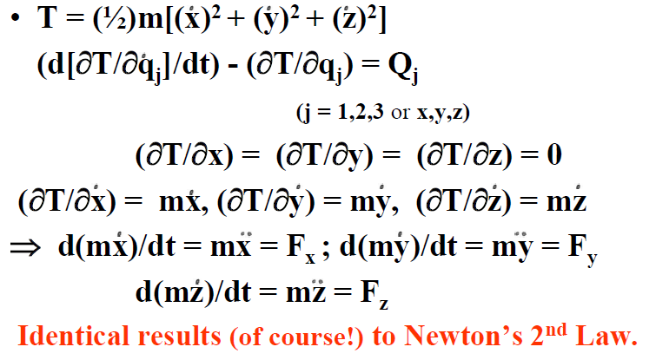

Slide 39
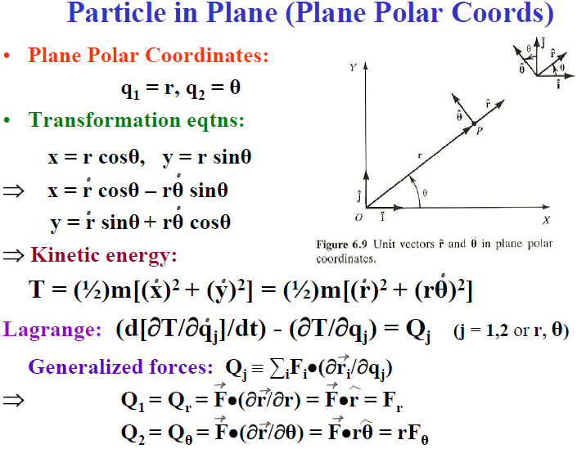

Slide 40
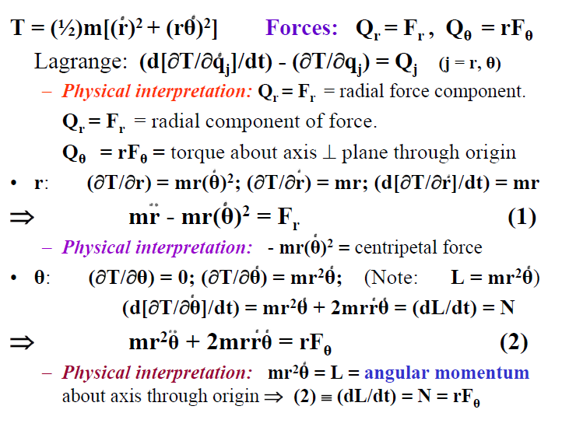

Slide 41
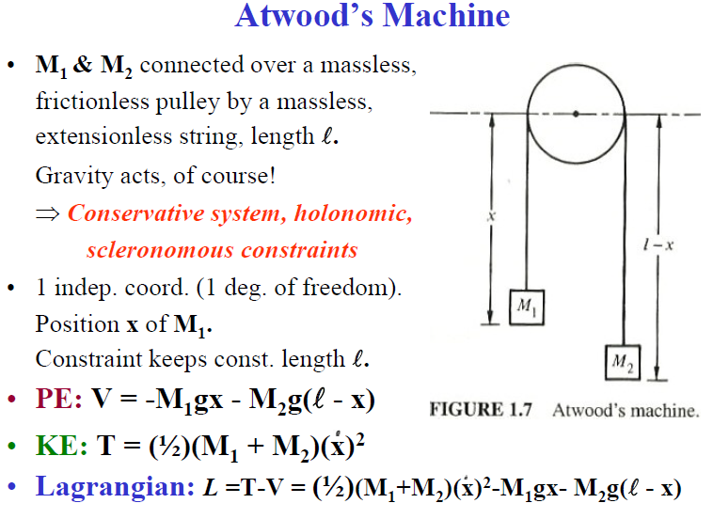

Slide 42
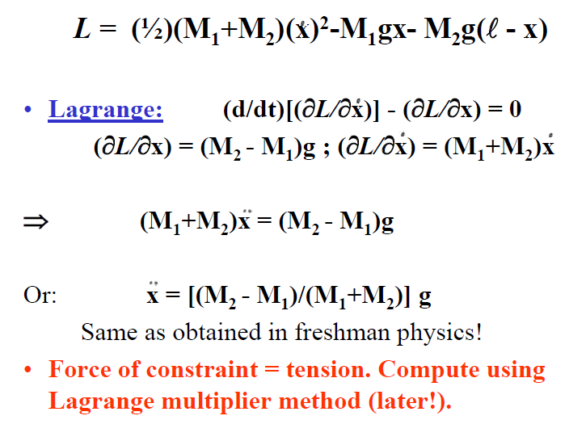

Slide 43
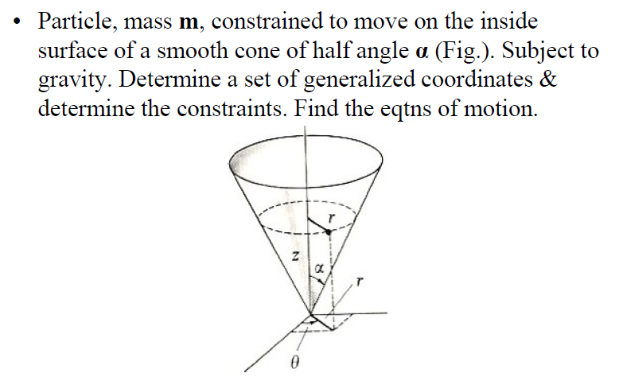

Slide 44
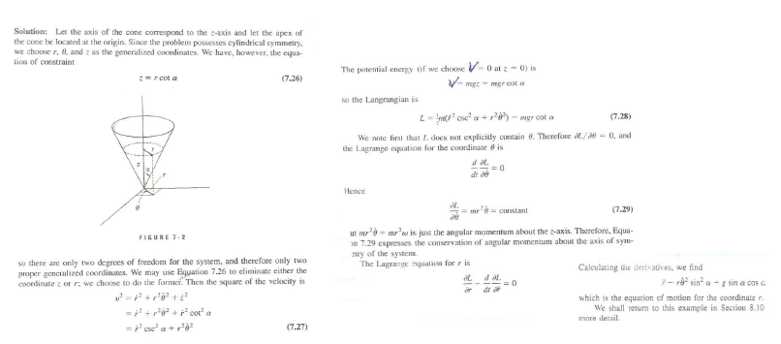

Slide 45
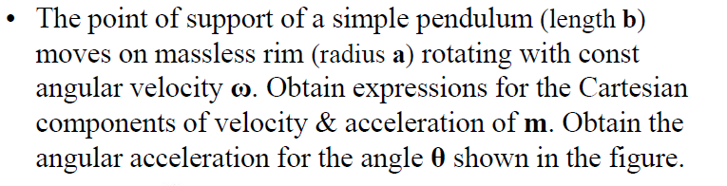
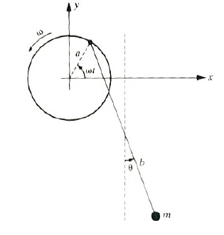

Slide 46
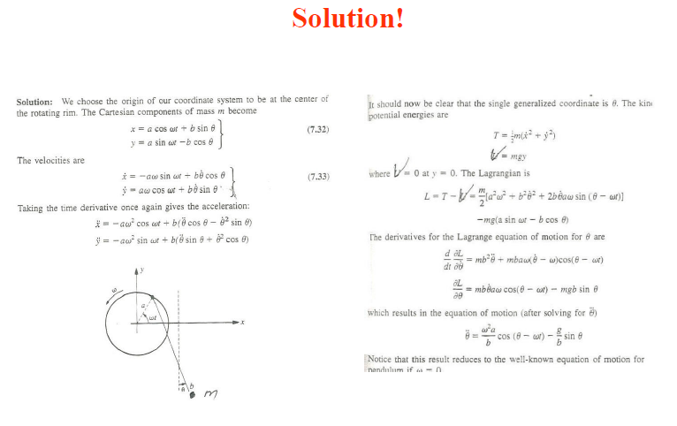

Slide 47
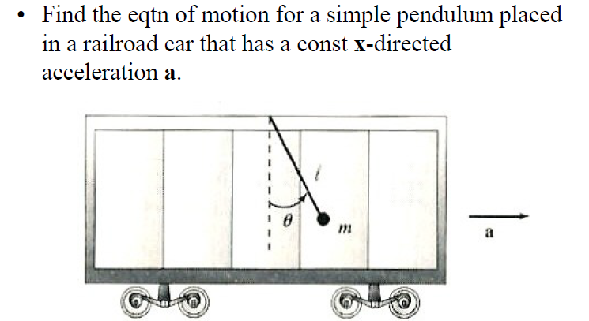

Slide 48
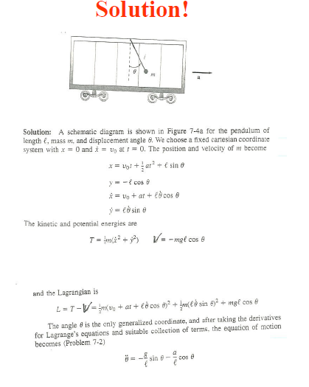

Slide 49
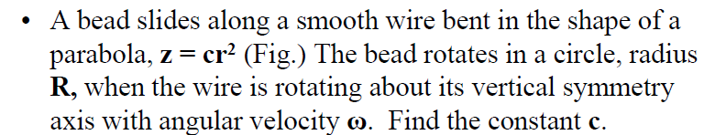
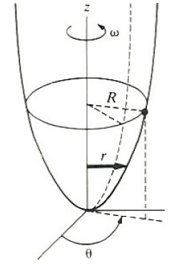

Slide 50
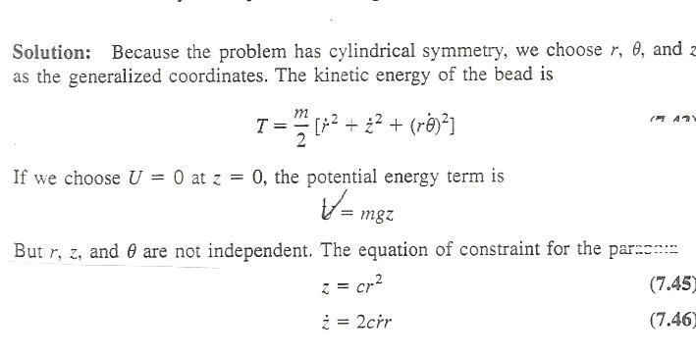
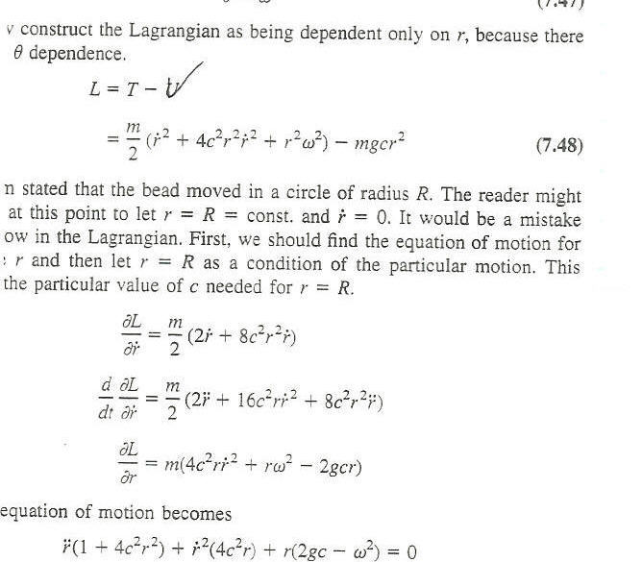
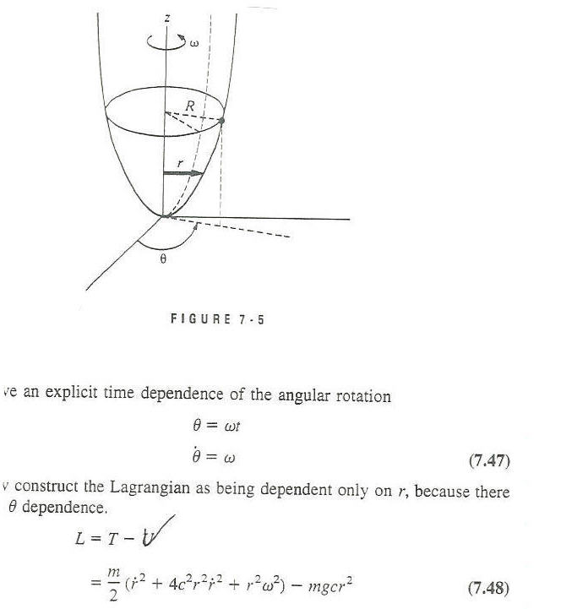
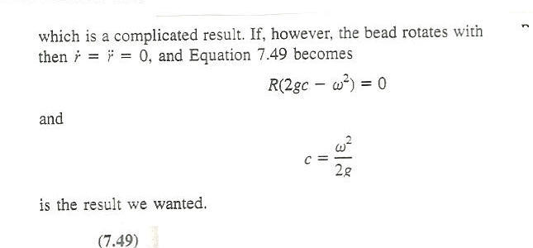
Solution!

Slide 51
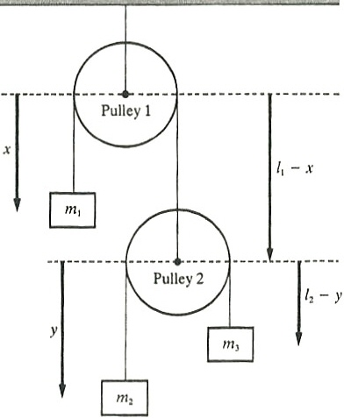
Consider the double pulley system shown. Use the coordinates indicated & determine the eqtns of motion.

Slide 52
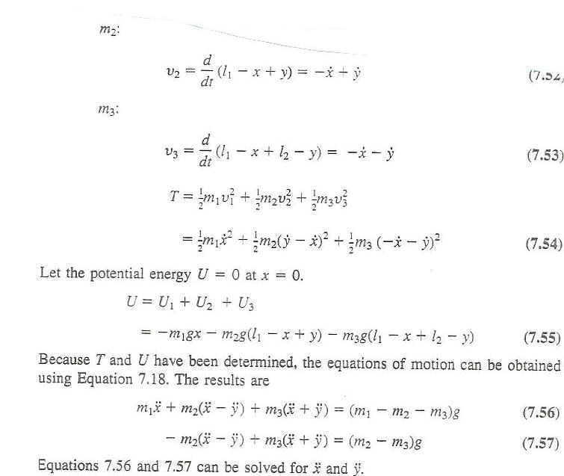
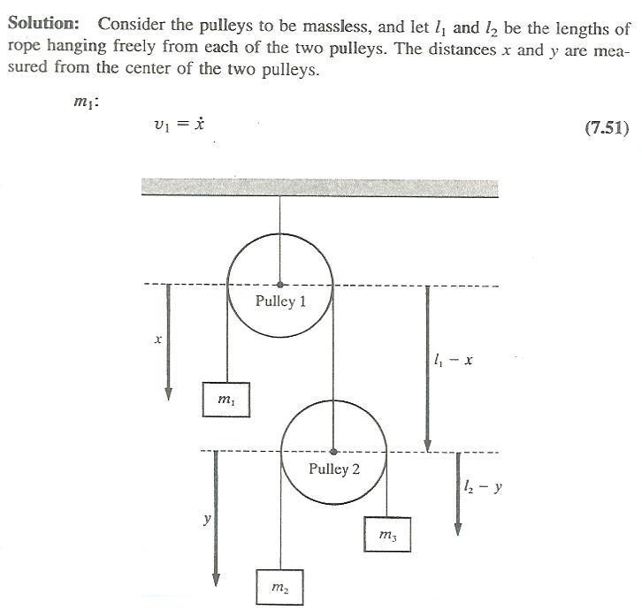
Solution!

Slide 53
Variational Principles & Lagrange’s Eqtns
Hamilton’s Principle
Our derivation of Lagrange’s Eqtns from D’Alembert’s Principle: Used Virtual Work - A Differential Principle. (A LOCAL principle).
Here: An alternate derivation from Hamilton’s Principle: An Integral (or Variational) Principle (A GLOBAL principle). More general than D’Alembert’s Principle.
Based on techniques from the Calculus of Variations.
Brief discussion of derivation & of Calculus of Variations. More details: See the text!

Slide 54
System: n generalized coordinates q₁,q₂,q₃,..q_{n}.
At time t₁: These all have some value.
At a later time t₂: They have changed according to the eqtns of motion & all have some other value.
System Configuration: A point in n-dimensional space (“Configuration Space”), with q_{i} as n coordinate “axes”.
At time t₁: Configuration of System is represented by a point in this space.
At a later time t₂: Configuration of System has changed & that point has moved (according to eqtns of motion) in this space.
Time dependence of System Configuration: The point representing this in Configuration Space traces out a path.

Slide 55
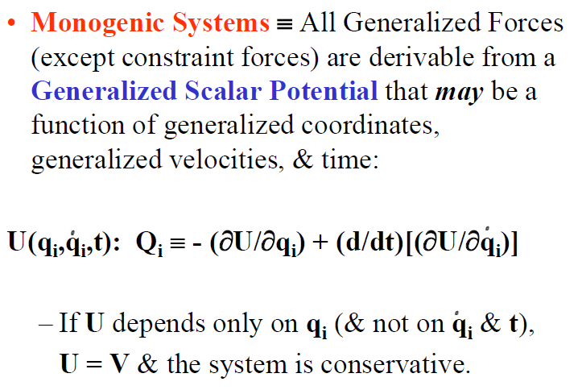

Slide 56
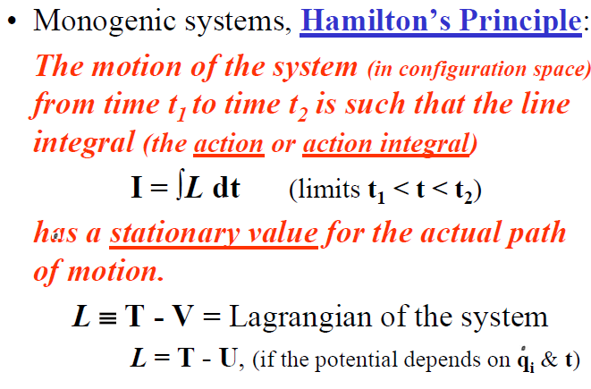

Slide 57
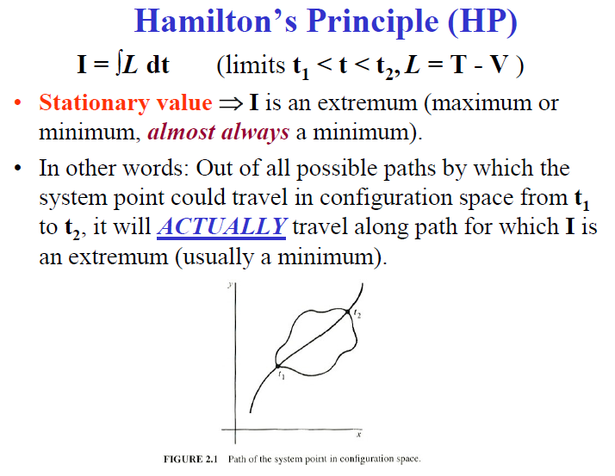

Slide 58
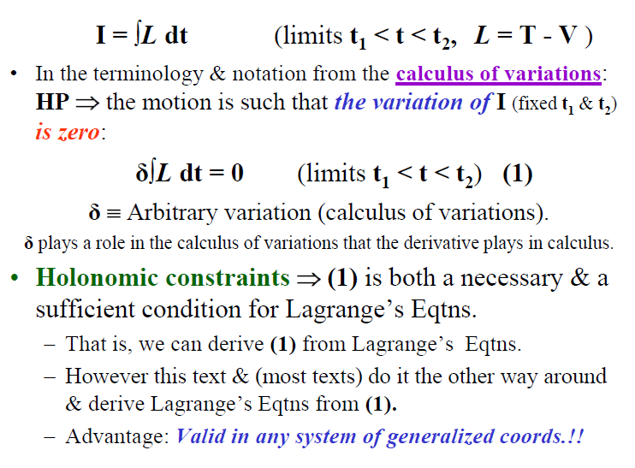

Slide 59
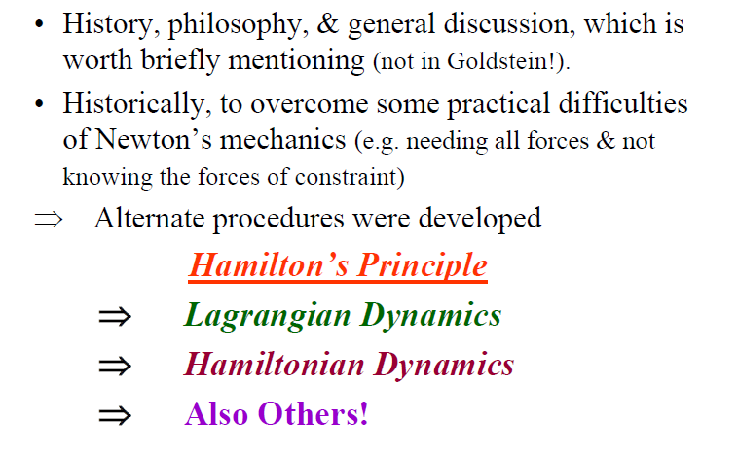

Slide 60
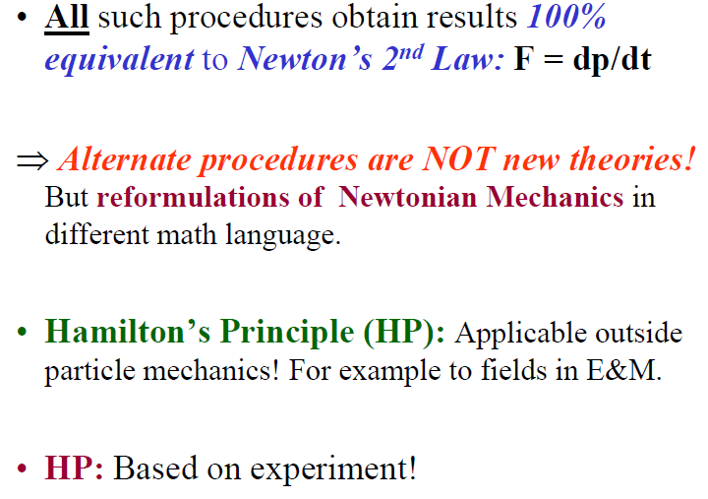

Slide 61
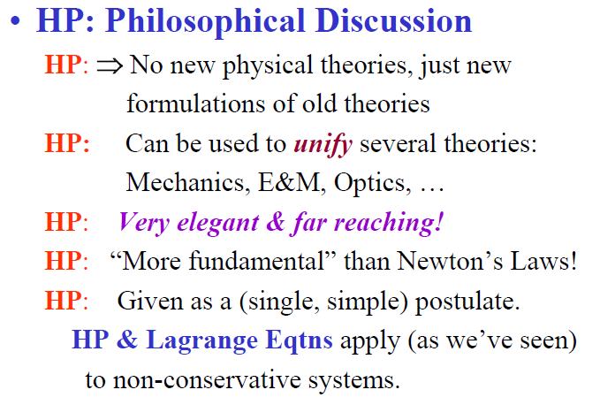

Slide 62
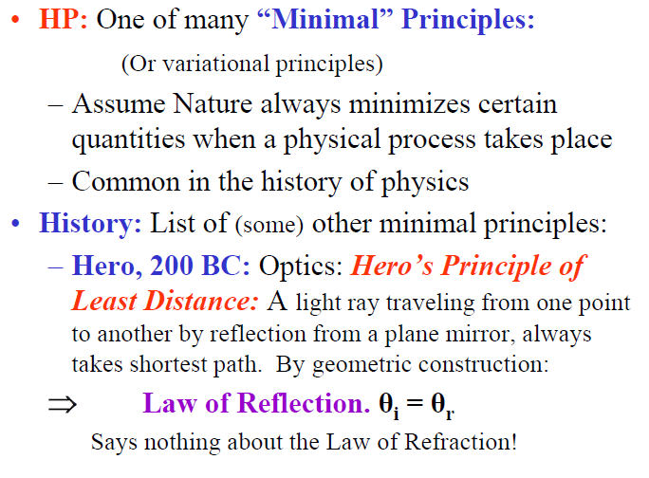

Slide 63
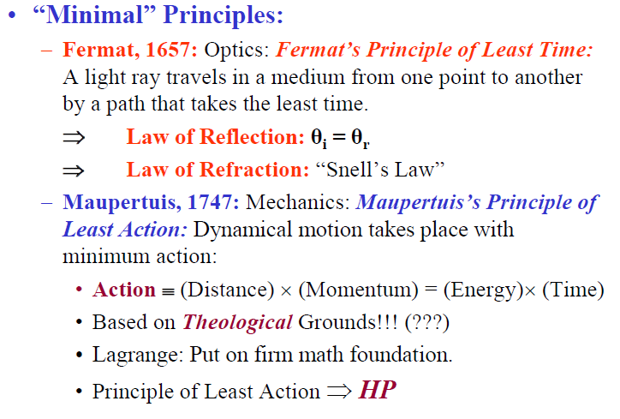

Slide 64
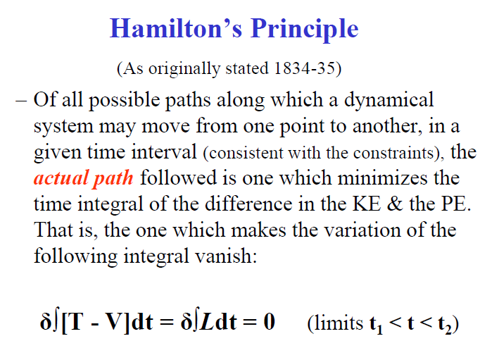

Slide 65
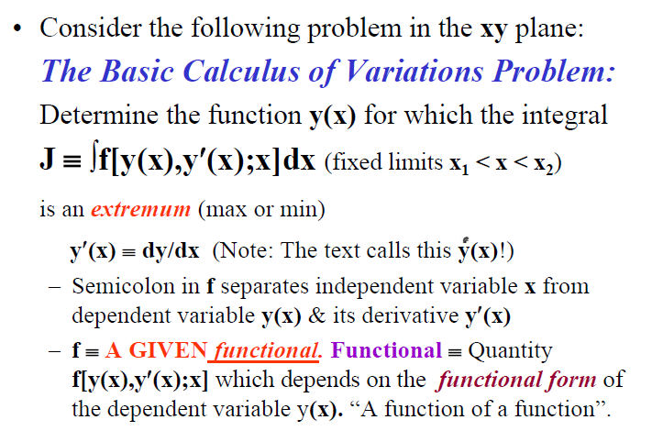

Slide 66
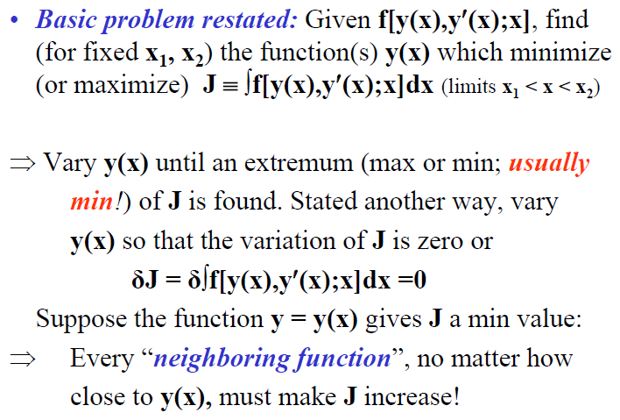

Slide 67
Solution to basic problem : The text proves that to minimize (or maximize)
J ≡ ∫f[y(x),y′(x);x]dx (limits x₁ < x < x₂)
or δJ = δ∫f[y(x),y′(x);x]dx =0
⇒ The functional f must satisfy:
(∂f/∂y) - (d[∂f/∂y′]/dx) = 0
≡ Euler’s Equation
Euler, 1744. Applied to mechanics
≡ Euler - Lagrange Equation
Various pure math applications,
Read on your own!

Slide 68
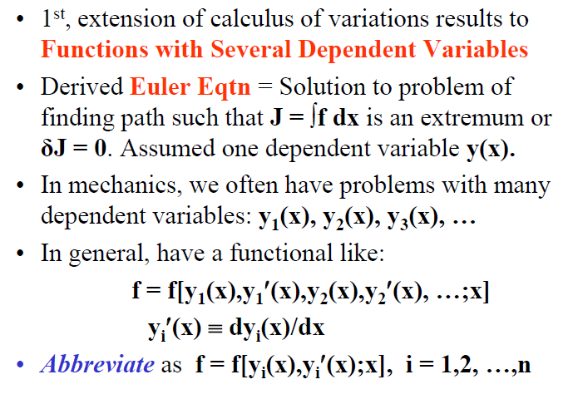

Slide 69
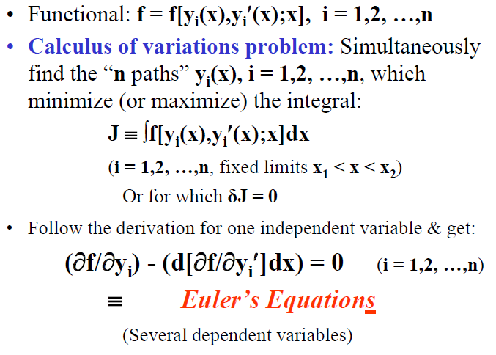

Slide 70
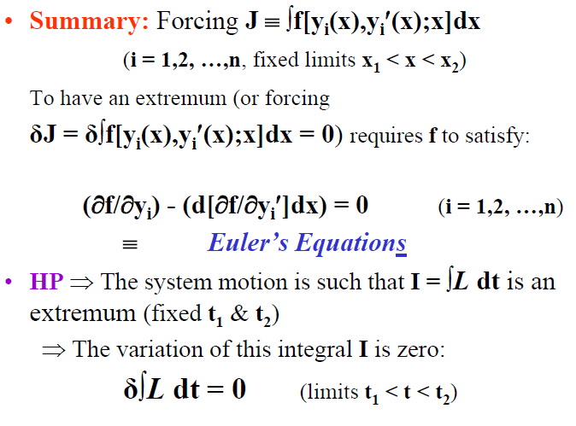

Slide 71
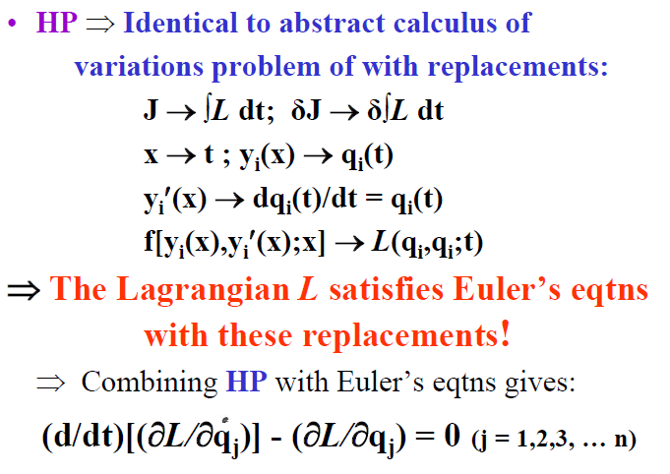

Slide 72
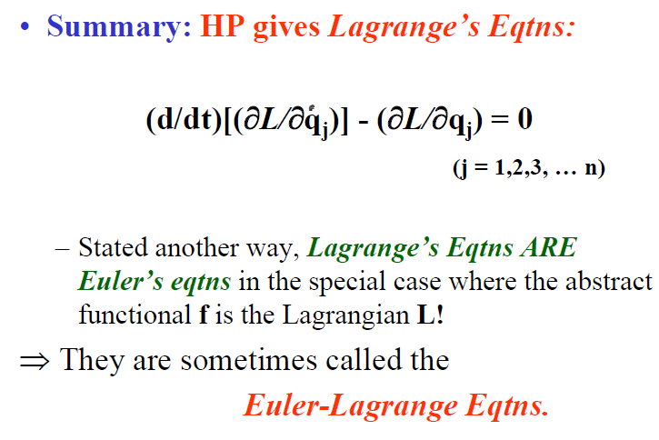

Slide 73
Advantages of a Variational Principle Formulation
HP ⇒ δ∫Ldt = 0 (limits t₁ < t < t₂). An example of a variational principle.
Most useful when a coordinate system-independent Lagrangian L = T - V can be set up.
HP: “Elegant”. Contains all of mechanics of holonomic systems in which forces are derivable from potentials.
HP: Involves only physical quantities (T, V) which can be generally defined without reference to a specific set of generalized coords.
⇒ A formulation of mechanics which is independent of the choice of coordinate system!

Slide 80
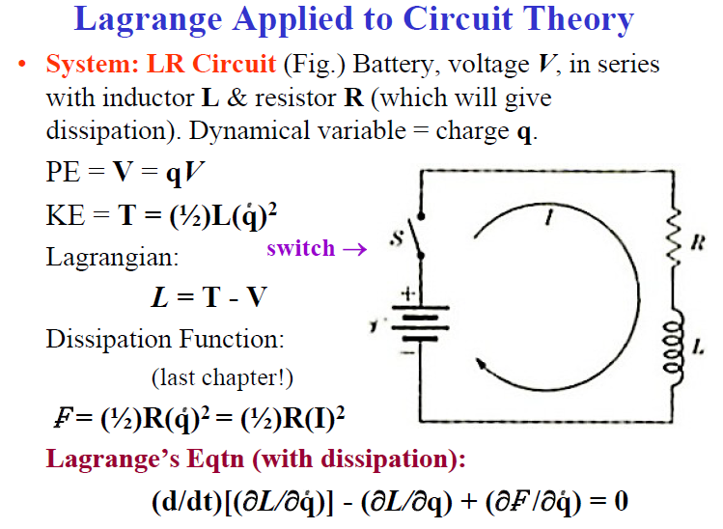

Slide 81
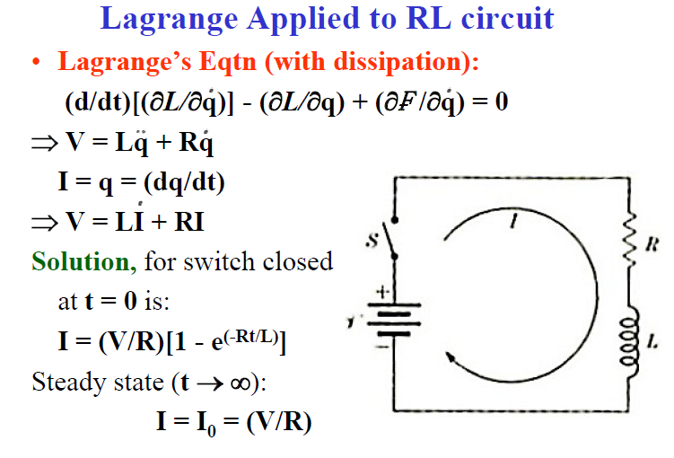

Slide 82


Slide 83


Slide 84


Slide 85


Slide 86


Slide 87


Slide 88


Slide 89


Slide 90


Slide 91


Slide 92


Slide 93


Slide 94


Slide 95


Slide 96


Slide 97


Slide 100
Hamiltonian’s Equations

Slide 102


